Slide 1
Using the Communicator.
This brief presentation will assist you with learning the basic functions of the
Communicator.
Please note that Mobile App methodology may differ slightly depending on your device and/ or operating system.

Slide 2
The School Communicator is an app that will pop up on your computer every day to keep you up to date with all the News, Events and Documents, etc within the school. It is also available as a mobile app.

Slide 3
Over 45,000 parents and almost 90 schools within the UAE are using the School Communicator daily.
Sept 2015.

Slide 4
Install on as many devices as you wish. It’s free!

Slide 5
For this presentation you will find the guides as follows:
Mobile app
Computer app
On the left
On the right

Slide 6
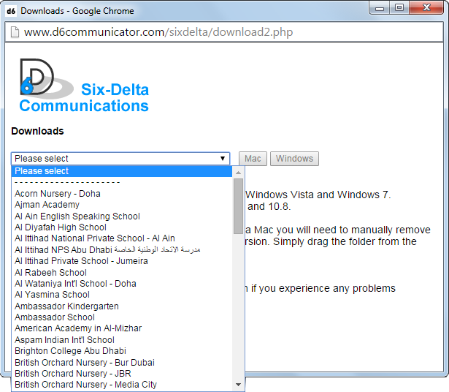
Install the Communicator App.
1
1
Visit www.six-delta.com
Search for ‘D6 School Communicator’ in your app store.
2
Select School Downloads.
Select your School.
Click on Mac or Windows.
Confirm download.
Allow installer to Run.
2
Install the App as per normal.
3
3
Register your details.
Select ‘Middle East’.
Select your School.
Allow to update.
3
Register your details.
Allow to update.
!
Recommend install the mobile app
over a Wi-Fi connection.

Slide 7
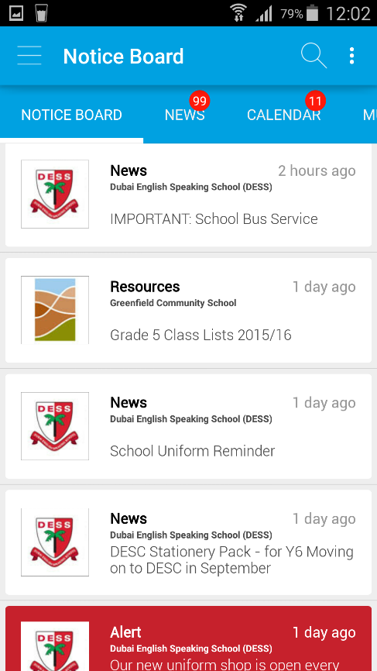
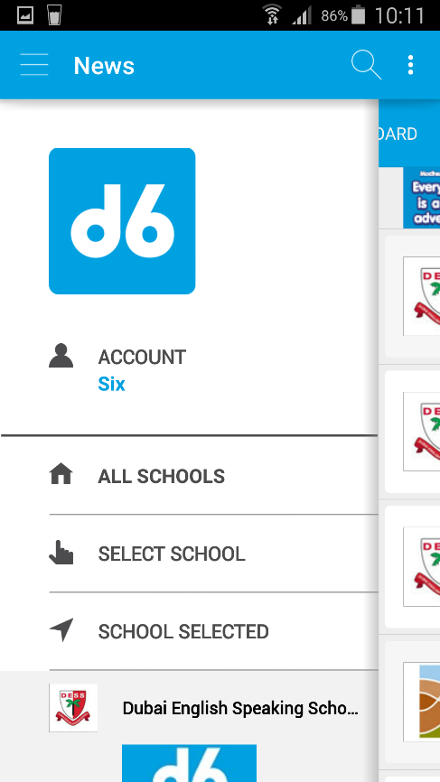
Use the menu button to view the full menu on the MOBILE app.
Menu Drawer

Slide 8
Please note that NO data entered by Parents or the School in to the School Communicator system will ever be sold to 3rd parties. All data is stored securely on the D6 Servers.

Slide 9
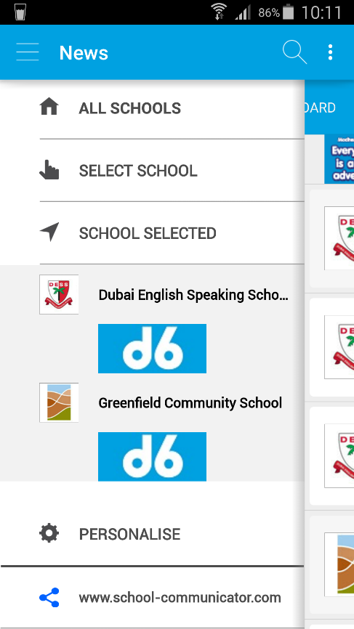
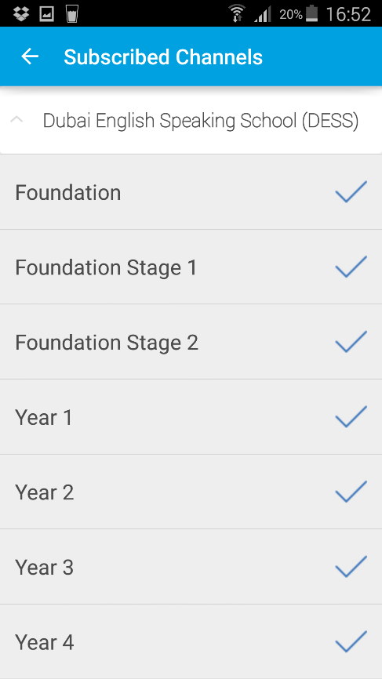
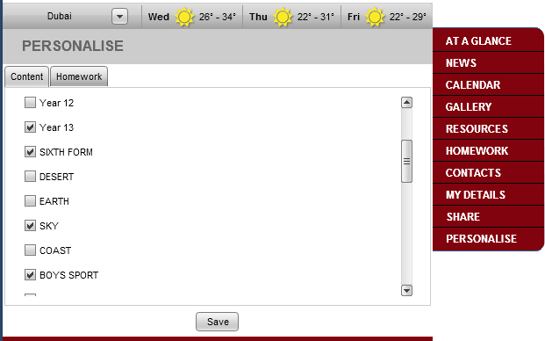
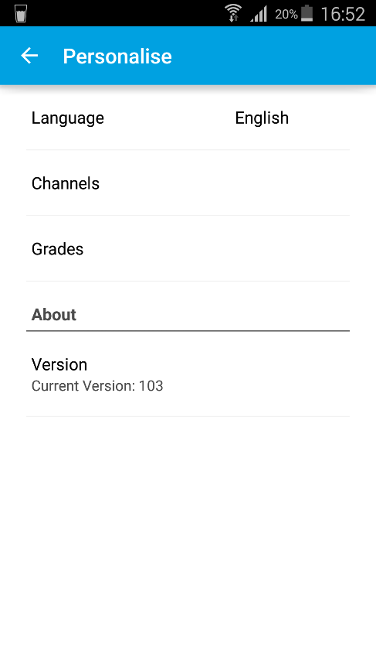
Once installed click or tap on Personalise to filter your CONTENT (Channels) feed.
4
Go ‘BACK’ when done.
Select/ Deselect as needed.
2
2
3
Select/ Deselect as needed.
Click on Save when done.
3
1
1
CHANNELS filter content for NEWS, CALENDAR & RESOURCES.

Slide 10
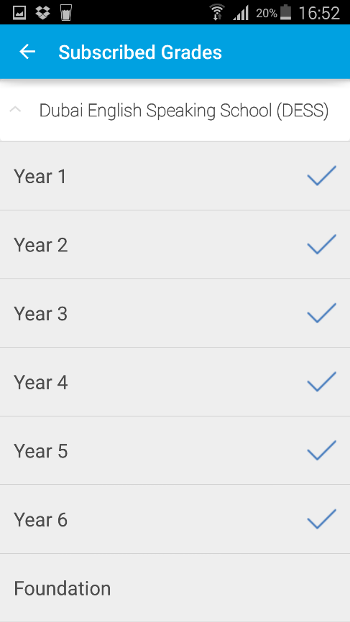
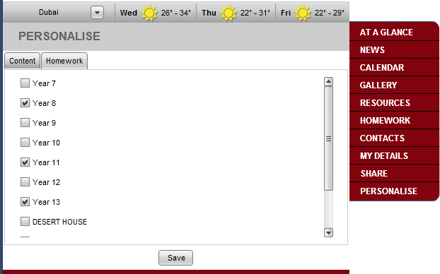
Click/ tap on Personalise to filter your HOMEWORK (Grades) feed. (note that some schools may not be using this function).
Go ‘BACK’ when done.
4
2
Select/ Deselect as needed.
2
3
3
1
Select/ Deselect as needed.
Click on Save when done.
1
Use CLASSES to filter your HOMEWORK feed.

Slide 11
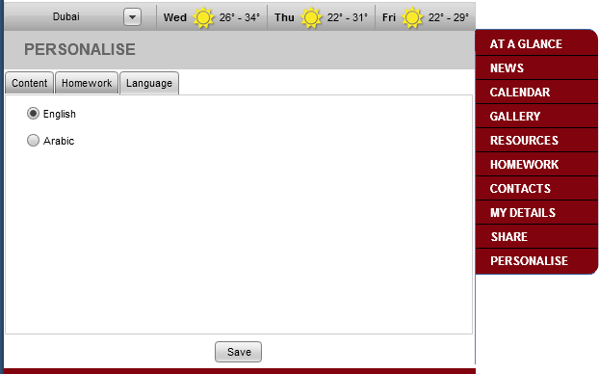
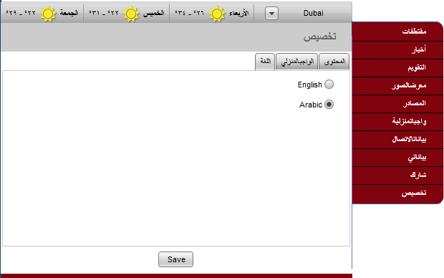
Click/ tap on Personalise to filter your Interface LANGUAGE. (For PC and Mac versions only).
2
Selecting Arabic will change the Interface to Arabic language.
1
3
* This setting does NOT translate the content that has been uploaded by the school *
Not currently available on mobile app version.

Slide 12
Communicator Sections.
What can be found where?

Slide 13
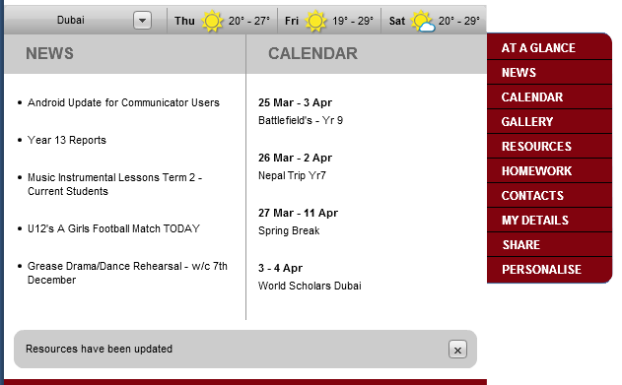
Noticeboard is the opening section.
Select your Weather feed.
Latest upcoming events.
Notifications.
News Item.
Resource Item.
Latest News Items.
Click to read.
Alert Item.
This section recently updated.

Slide 14
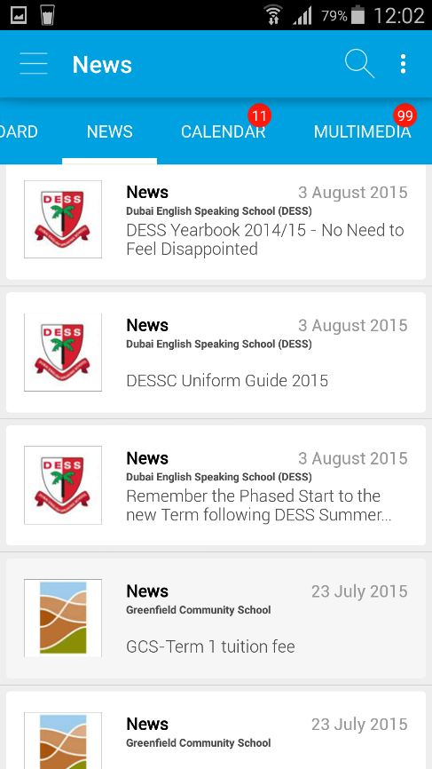
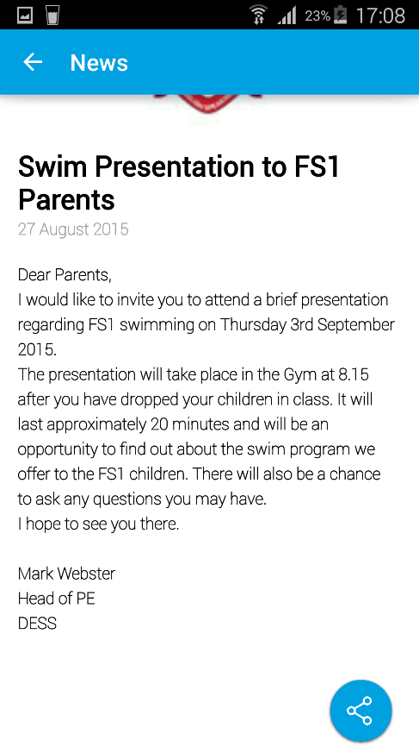
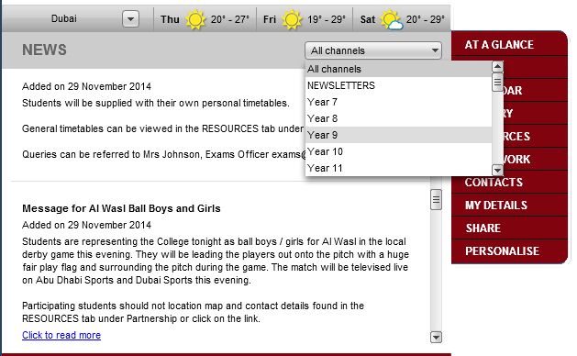
NEWS contains brief articles and overviews.
Quick Filter News Items by Channels.
1
Tap to share.
2

Slide 15
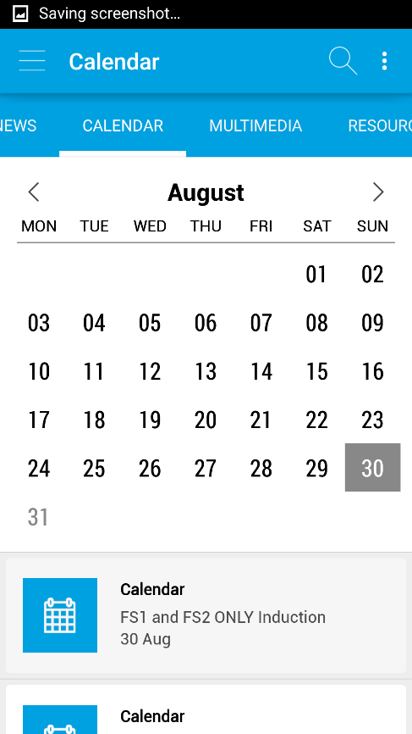
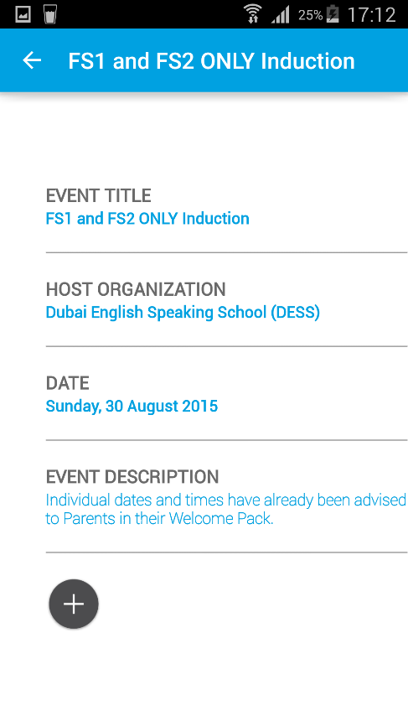
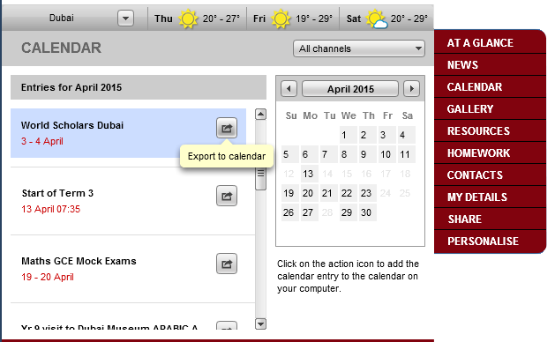
CALENDAR contains upcoming events.
Quick Filter Items by Channels.
1
2
1
2
Click to add to your OUTLOOK calendar.
Tap to add to your Personal Calendar.
3
3

Slide 16
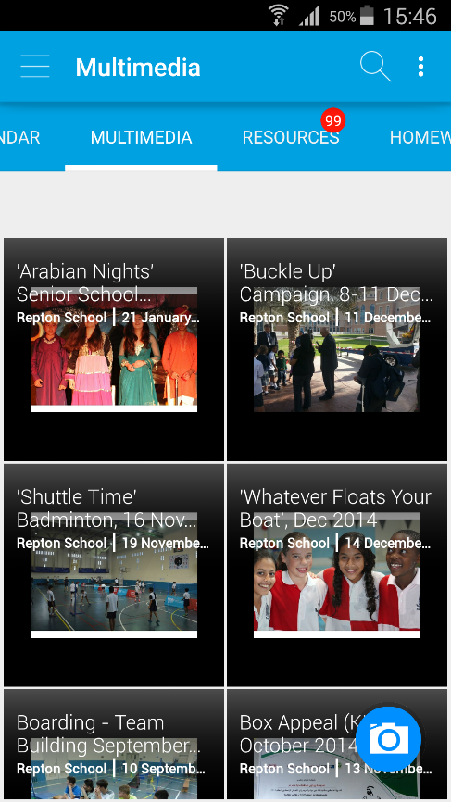
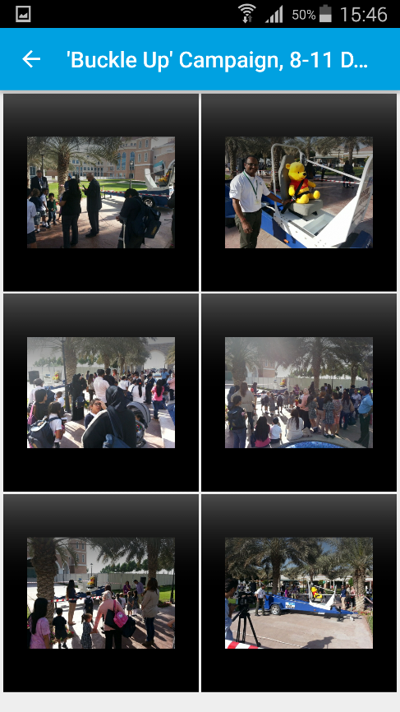
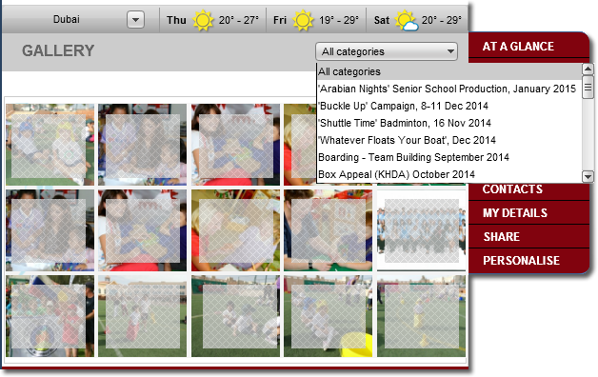
GALLERY/ MULTIMEDIA contains a selection of photos.
Filter Photo’s by Albums
1
2
Tap to view the enlarged photo.
Click to view the enlarged photo.
3
If you wish to obtain a copy of any photo’s you should contact the School Administration.

Slide 17
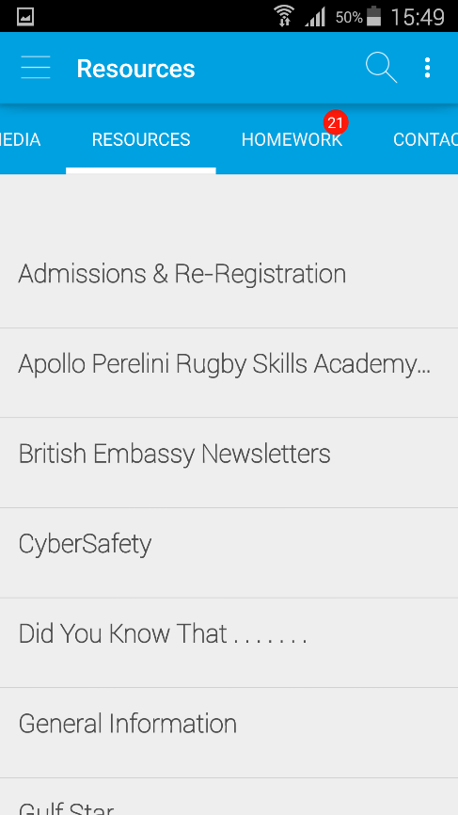
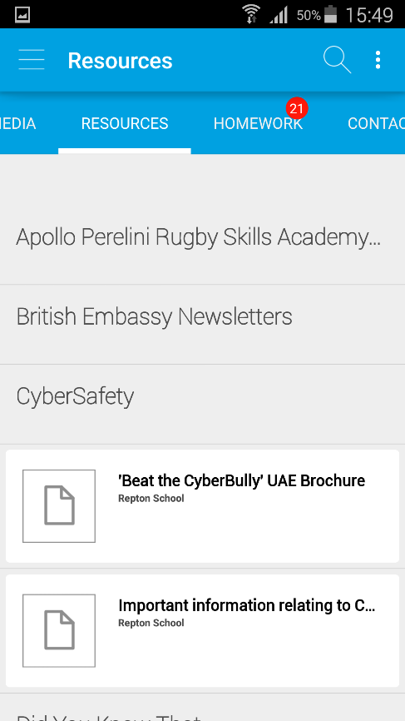
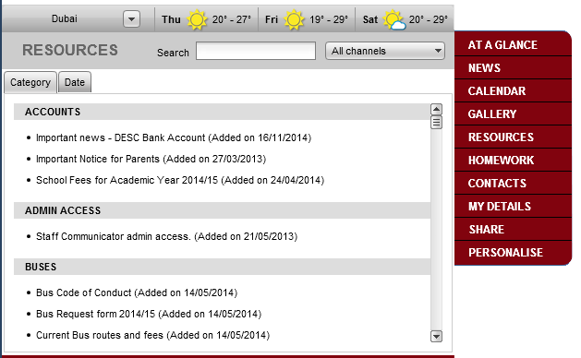
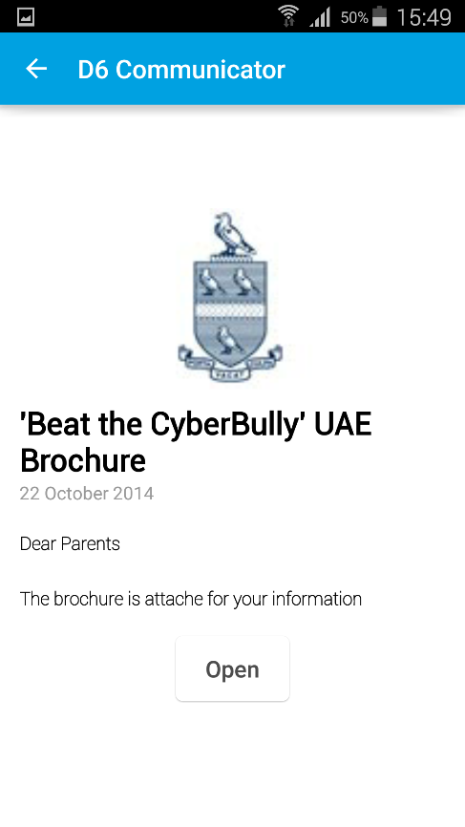
RESOURCES are viewable and printable documents or web links.
Filter by Channel.
1
View by Category or Sort by date.
Search by Keyword.
2
3
Click to open the document.
Tap to view document.
4

Slide 18
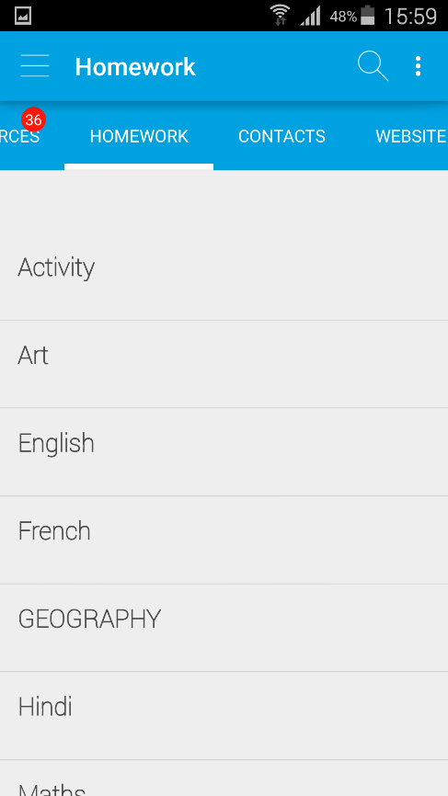
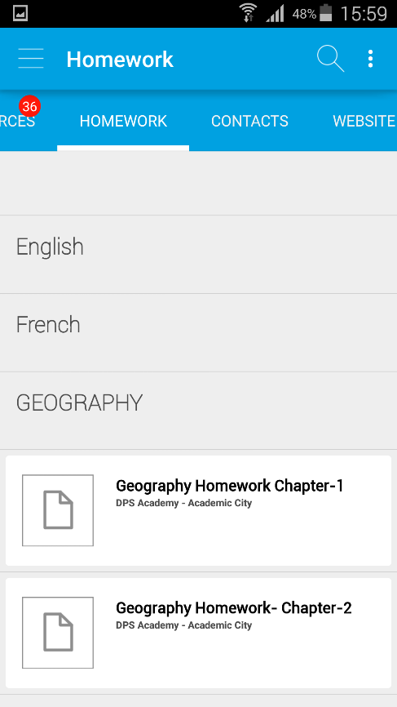
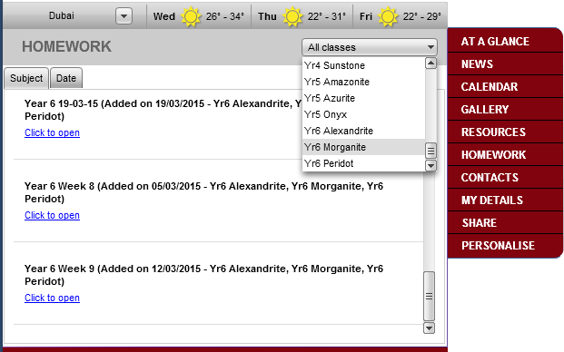
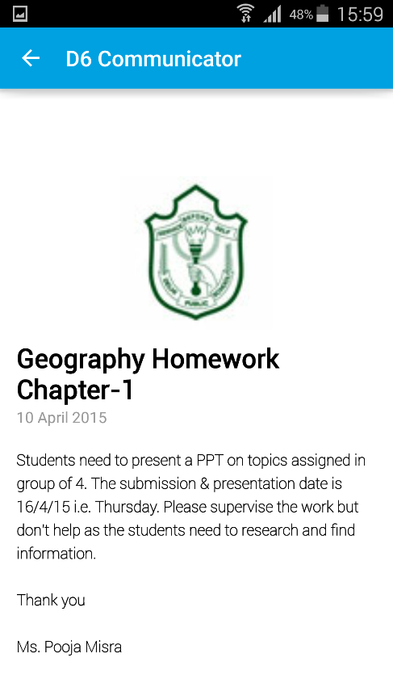
HOMEWORK contains viewable and printable documents or learning web links.
Filter by Classes.
Sort by Subject or Date.
1
2
3
Click to open the document.

Slide 19
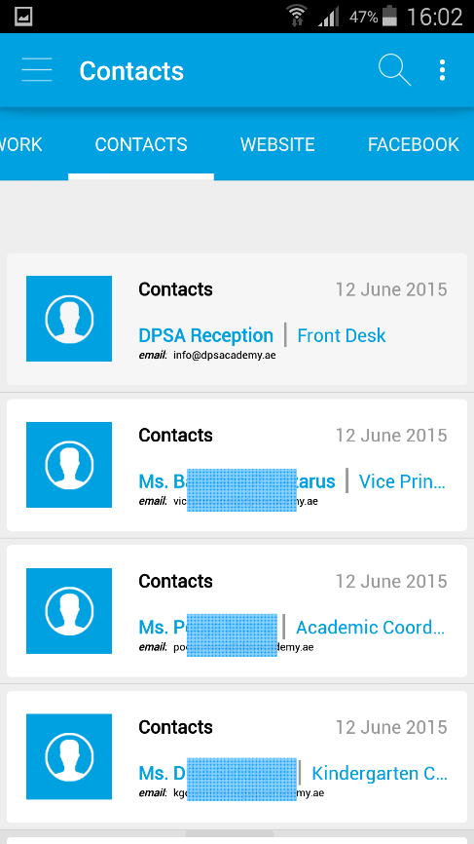
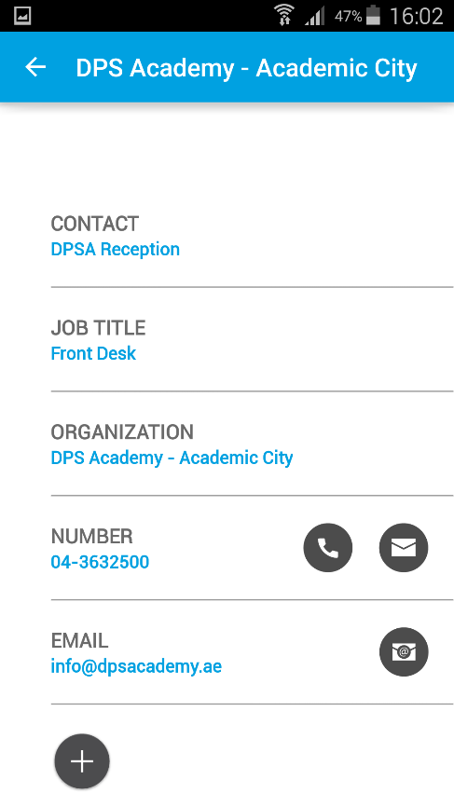
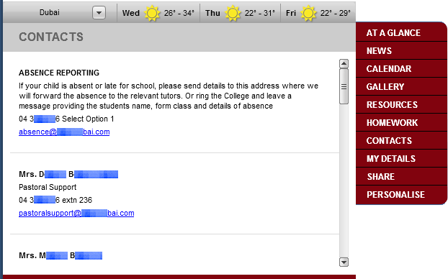
CONTACTS. Phone, E-mail or Text the contacts.
1
2
1
Tap a contact to Call, Text
or e-mail them.
Click to email the school contact.
2
3

Slide 20
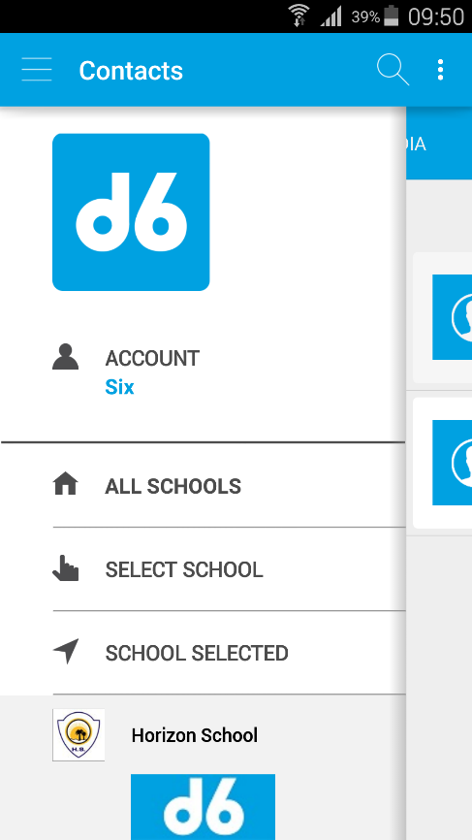
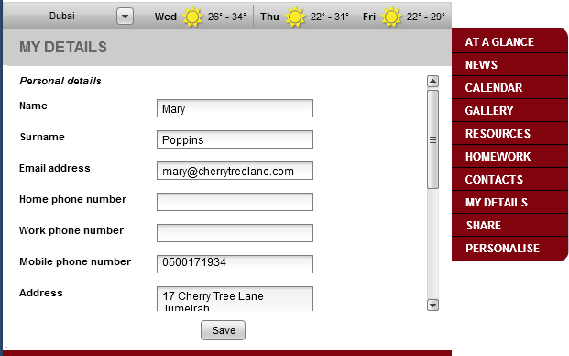
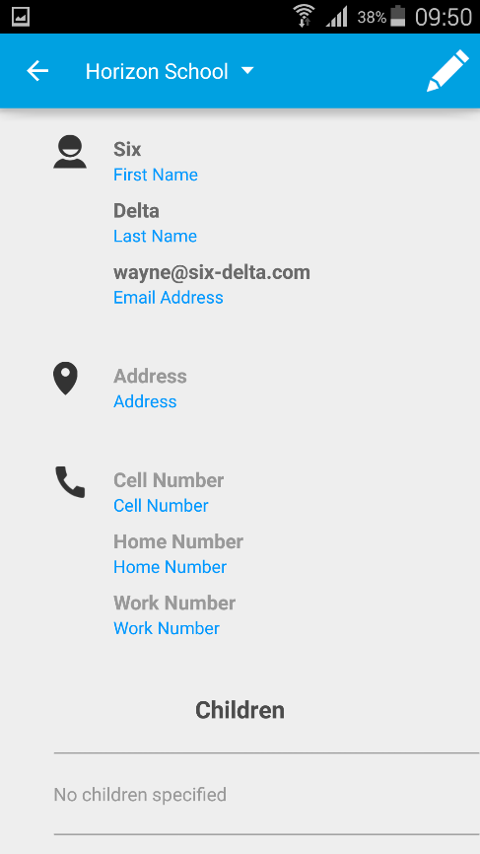
MY DETAILS. Update your personal details here so that the School has your latest information.
Tap to Edit.
Tap to Save once done.
Update or Edit your personal details to send to the School.
2
2
1
1
3

Slide 21
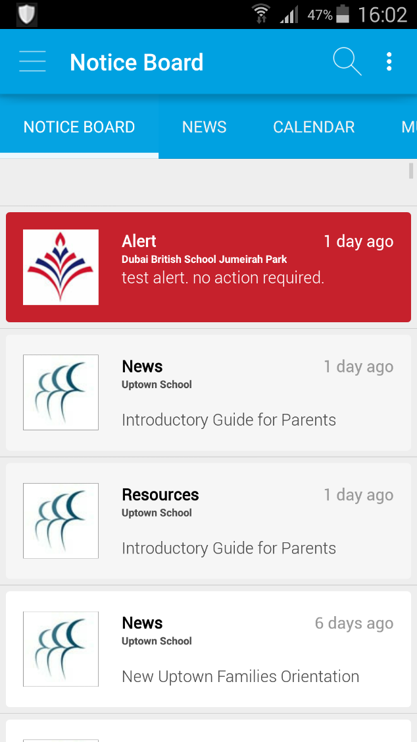
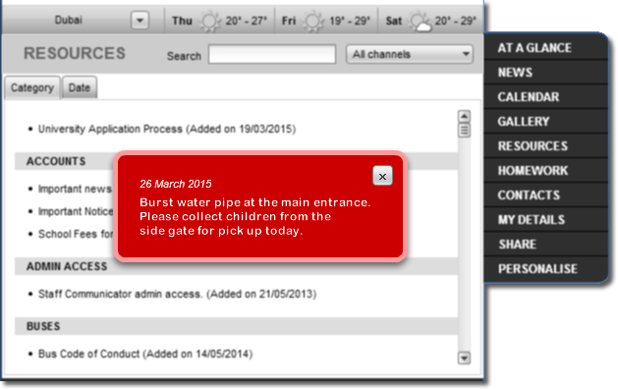
ALERTS. Some important information for you to be aware of .
Your mobile notifications will alert you.
The Communicator will pop up on your computer screen when an Alert occurs.

Slide 22
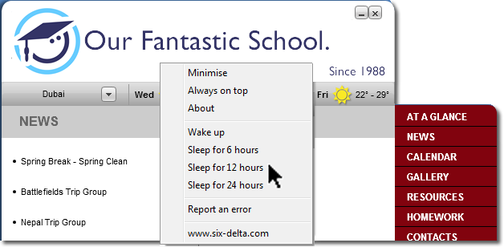
Want to prevent your Communicator from popping up on the Computer?
1
Right click on the header section to bring up menu.
2
Select sleep period.
Report an Error
Not currently available on mobile app version.
!
!!! Enabling Sleep will also disable Alerts !!!

Slide 23
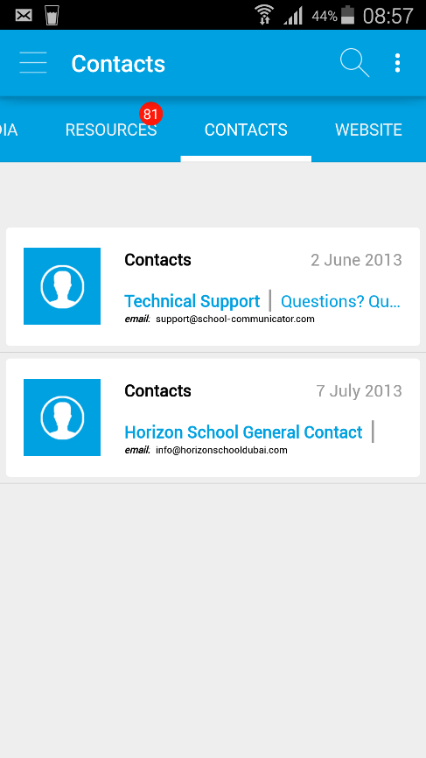
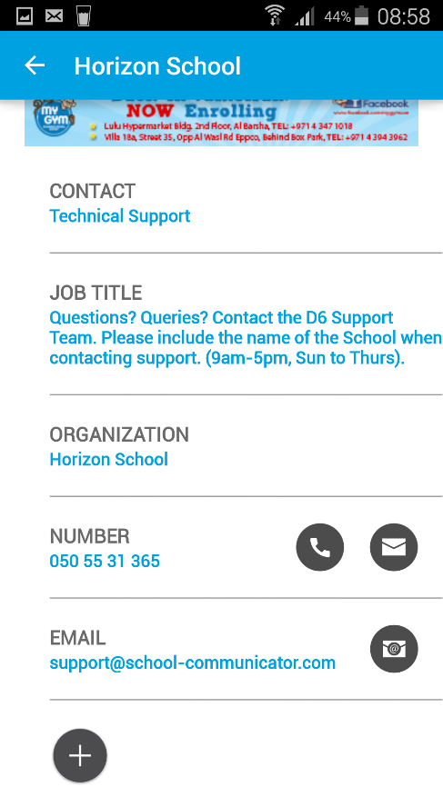
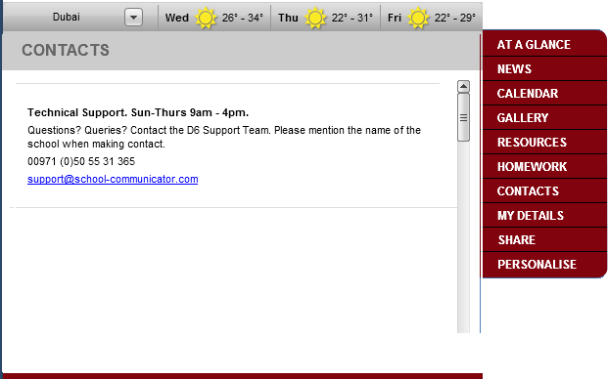
Need to contact Six-Delta for assistance? We’re in the CONTACTS Section.
1
2
1
Tap a contact to Call, Text
or e-mai.
3
Support Timings: 9am – 5pm, Sunday to Thursday.

Slide 24
Please note that if you have not opened the Computer application for a few days (or weeks) it may take some time to update all the new information depending on your internet connection speed.

Slide 25
Follow us on Twitter. @School_Comm
Thank you.
We hope you enjoy using the School Communicator.
** END **

